Slide 1

Presentation on “Sugarcane Crop Support System”
SAPTHAGIRI COLLEGE OF ENGINEERING
(Affiliated to Visvesvaraya Technological University, Belagavi & Approved by AICTE, New Delhi.)
Department of Computer Science & Engineering
Presented By:
Under the Guidance of :
Prof. Anuradha B
Assistant Professor,
Dept. of CSE
ASHWIN RAMESH P | 1SG16CS016
BINDHU MV | 1SG16CS020
DIVIJ N | 1SG16CS029
DIVYA K | 1SG16CS030

Slide 2
ABSTRACT
Sugarcane crop is grown in more than 90 countries and accounts upto 70% of sugar . Along with the diversity in the crop there is a huge spectrum of disease the plant can acquire.
The system is designed for accurate detection and suggestion of appropriate remedial measures.

Slide 3
INTRODUCTION
Sugarcane is the world's largest crop by production quantity, with 1.9 billion tonnes produced in 2016.
It is cultivated on about 26 million hectares.
Pests, insects, pathogens infect the plants resulting in decrease in the production to large scale if not controlled within time.
The proposed system mainly deals with Detection and Prevention of sugarcane diseases.

Slide 4
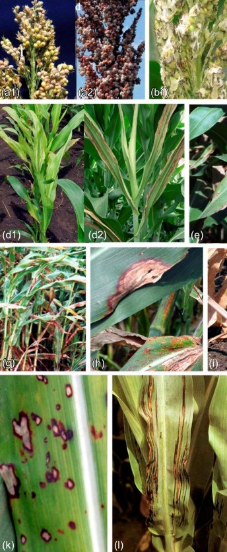
PROBLEM STATEMENT
To design and develop a system for detection and prevention of major sugarcane diseases.

Slide 5
OBJECTIVE AND SCOPE
Design an efficient system which identifies the disease in sugarcane crop
Use image processing, classify the disease, and provide accurate remedy.
Help the farmers to enhance their crop yield, by reducing the crop loss due to preventable diseases.

Slide 6
LITERATURE SURVEY
Title 1 | Author and published year | Methodology | Limitations
Detecting Sugarcane Borer Diseases Using Support Vector Machine | Tisen Huang , Rui Yang, Wenshan Huang , Yiqi Huang , Xi Qiao 2017 | Sugarcane borer disease is detected using grayscale conversion for image processing ,and SVM algorithm for classification | SVM is applicable only for linear dataset The proposed system is confined to only detect stem related disease

Slide 7
LITERATURE SURVEY
Title 2 | Author and published year | Methodology | Limitations
Sugarcane Disease Detection Using Data Mining Techniques | S Sathiamoorthy, R Ponnusamy, M Natarajan 2018 | R Datasets are used for experimental studies .Techniques like k means ,MLP are used to predict sugarcane leaf disease | R Dataset considers only limited attributes and thus cannot be generalized. The proposed system addresses detection of “coal of sugarcane disease”

Slide 8
LITERATURE SURVEY
Title 3 | Author and published year | Methodology | Limitations
Novel Machine Learning Based Approach For Detection And Classification Of Sugarcane Plant Disease By Using DWT | B Sravya Reddy, R Deepa, S Shalini, P Bhagya Divya 2017 | Detection of disease is done using discrete wave length transform algorithm and decision tree approach to classify the disease. Infected plant images are stored in the database. | Specific only for leaves. A high end camera is required to capture images and store it in the dataset. Only certain diseases are addressed.

Slide 9
PROPOSED SYSTEM
Android app
Cloud
(Detection and Classification)
Remedies

Slide 10
MODULE SPECIFICATION
Preparing data for the experiments
Image Acquisition
Image Pre-Processing
Image Segmentation
Feature Extraction
Detection and classification of plant disease

Slide 11

IMAGE ACQUISITION
Principle phase which incorporates uploading the image of the crop.

Slide 12
IMAGE PRE-PROCESSING
Improvement of image data to enhance its quality.
Contrast Stretching
Resizing
RGB Threshold

Slide 13
IMAGE SEGMENTATION
Extract the infected region of the plant from the images uploaded.
Partitioning a digital image into multiple segments
Representation of an image into something that is more meaningful and easier to analyze.

Slide 14
FEATURE EXTRACTION
Classify a set of features representing characters
Maximize the disease recognition rate.

Slide 15
POSSIBLE OUTCOMES
Interactive UI for real time users
Accurate prediction of disease
Suggesting Remedial measures

Slide 16
THANK YOU

